Slide 1
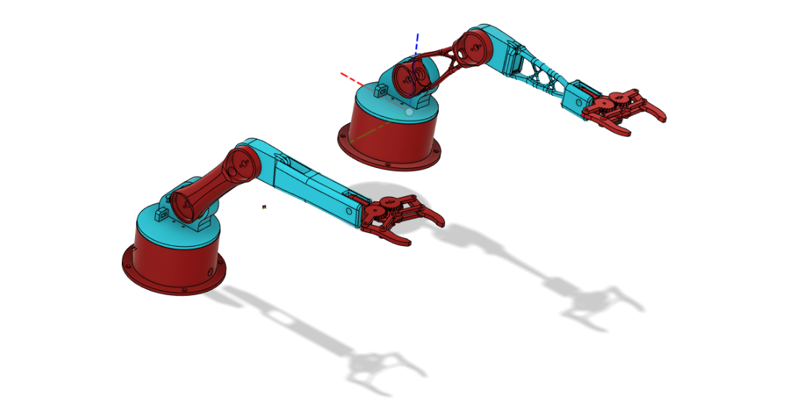

ROBOT ARM CONTROL WITH HAPTIC FEEDBACK
YILDIZ TECHNICAL UNIVERSITY
FACULTY OF MECHANICAL ENGINEERING
2006A601 Kadir Kadiroğlu 1806A038 Oğuzhan Can 1906A602 Özkan Yaşar
Project Advisor: Assoc. Prof. Hüseyin Ayhan Yavaşoğlu

Slide 2
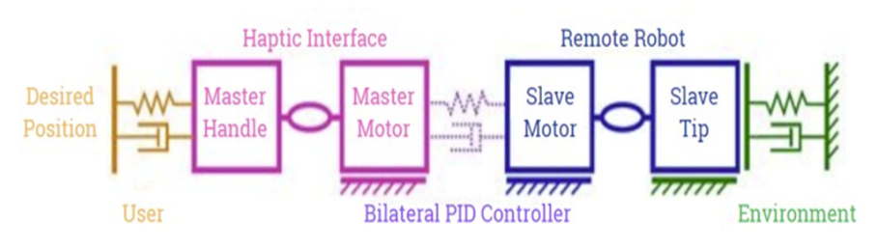
INTRODUCTION

Slide 3
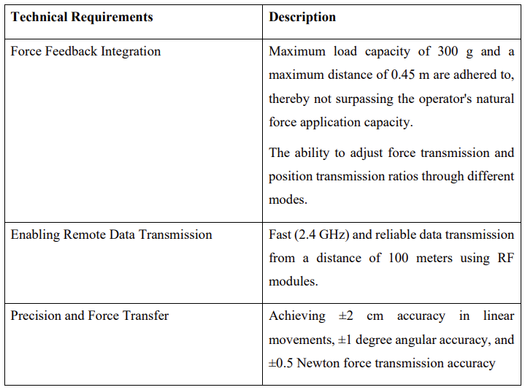
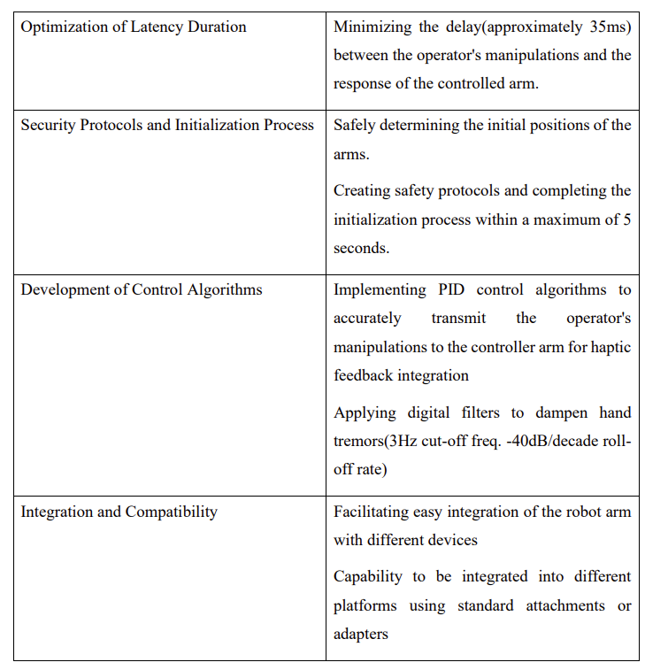
TECHNICAL REQUIREMENTS & DESIGN SPECIFICATIONS

Slide 4
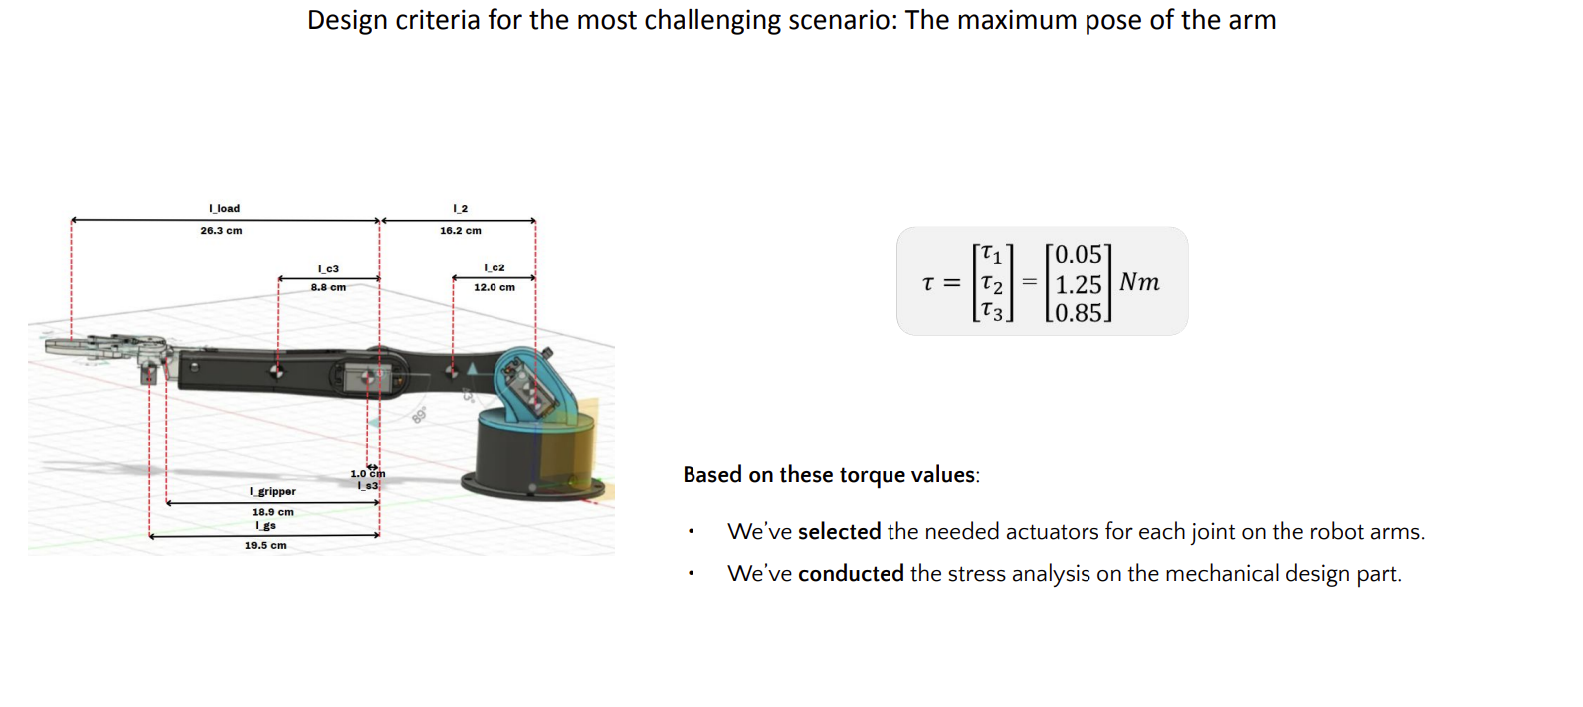
Dynamic Equation Calculations

Slide 5
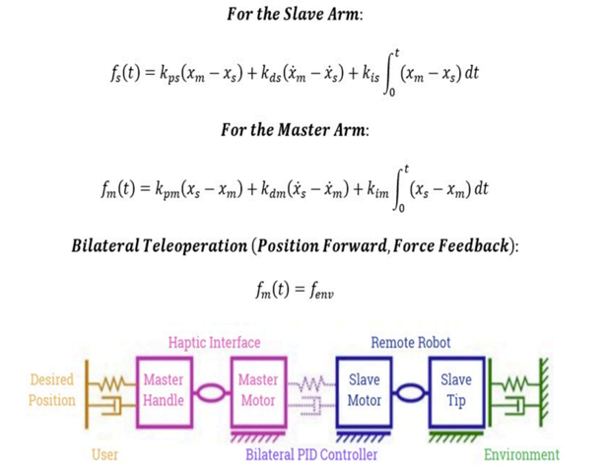
Bilateral Operation Equations

Slide 6
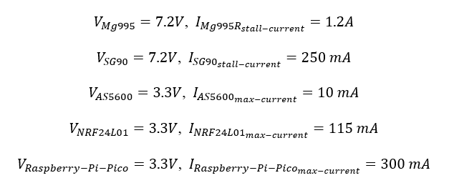
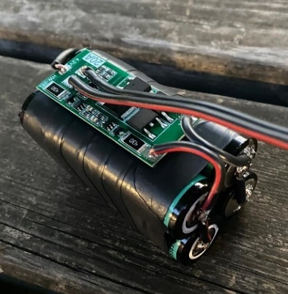
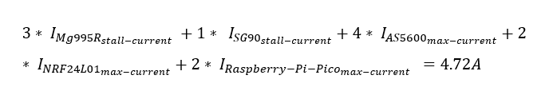
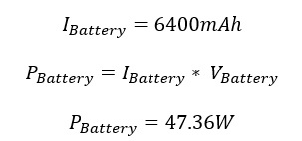
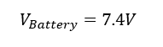
Battery Selection & Power Calculation

Slide 7
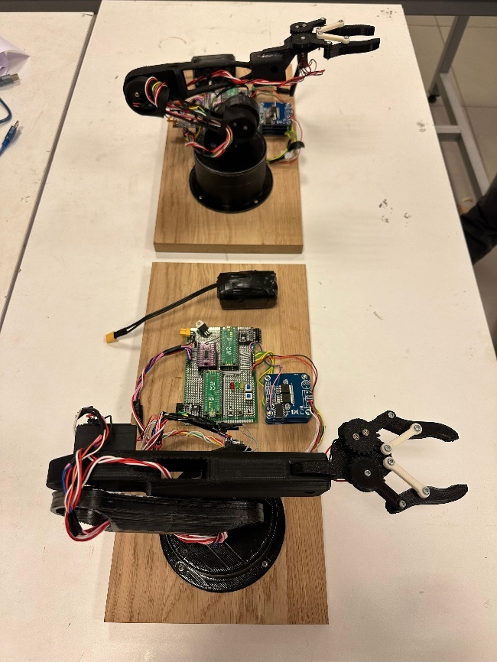
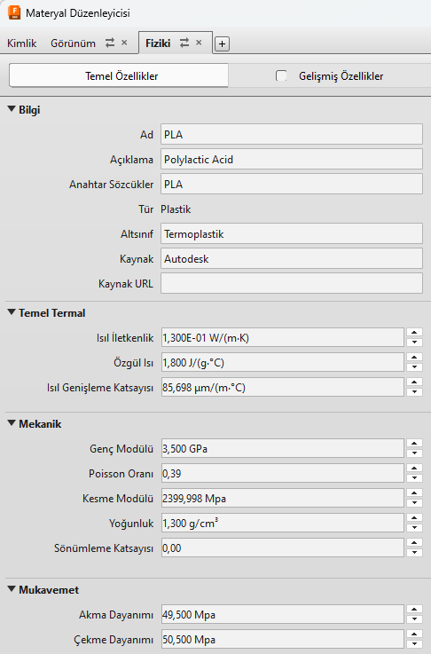
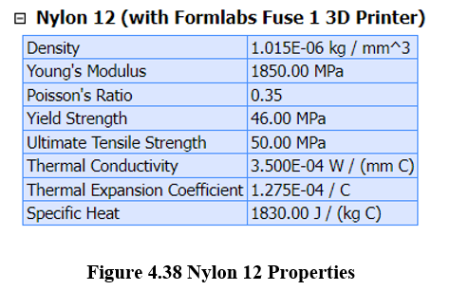
Mechanical Design

Slide 8
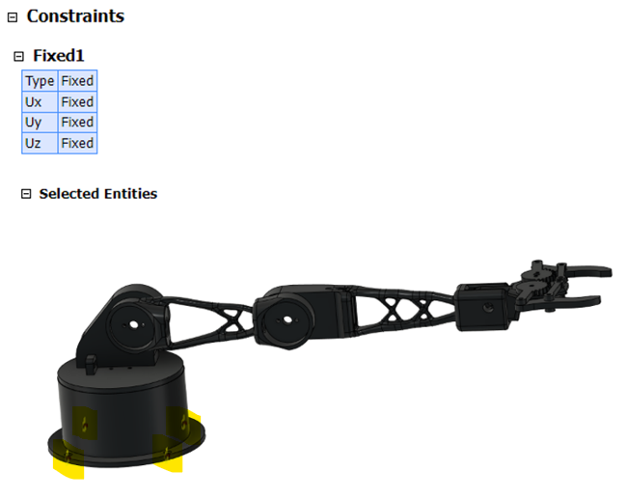
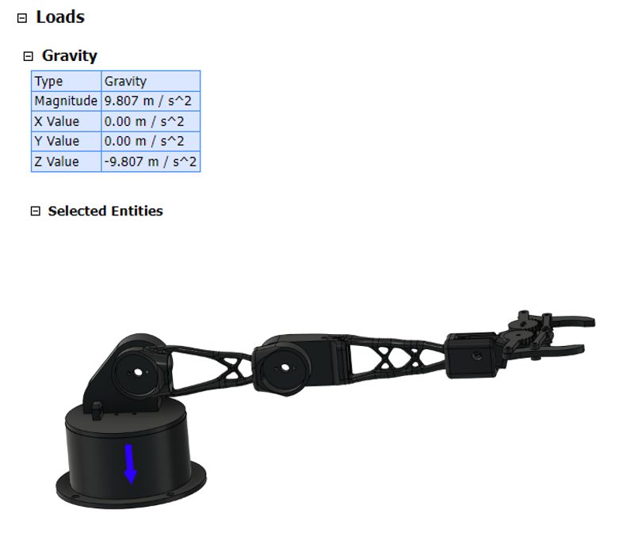
Stress Analysis

Slide 9
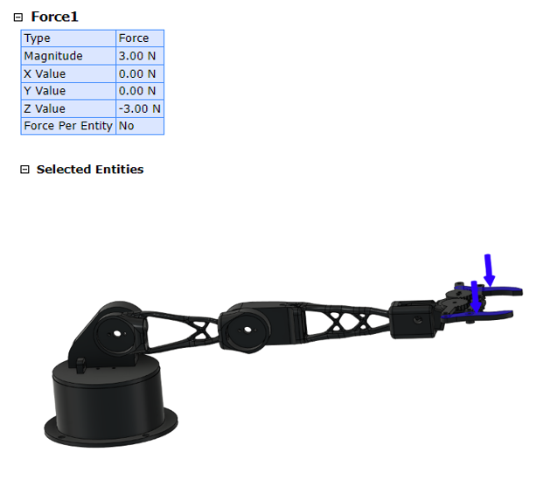
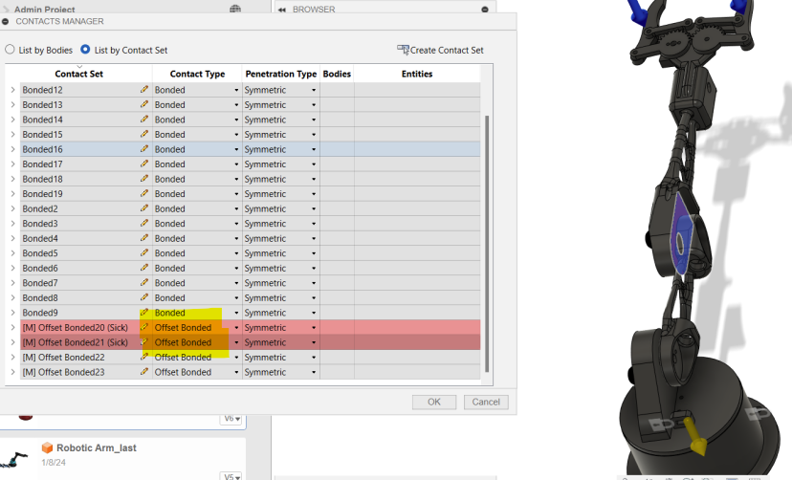
Stress Analysis

Slide 10
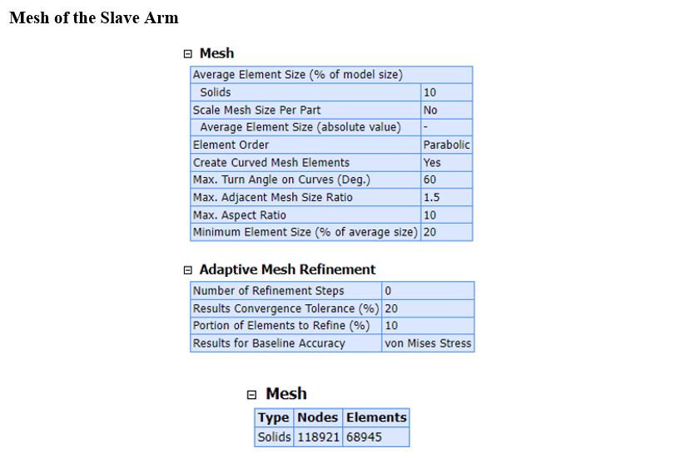
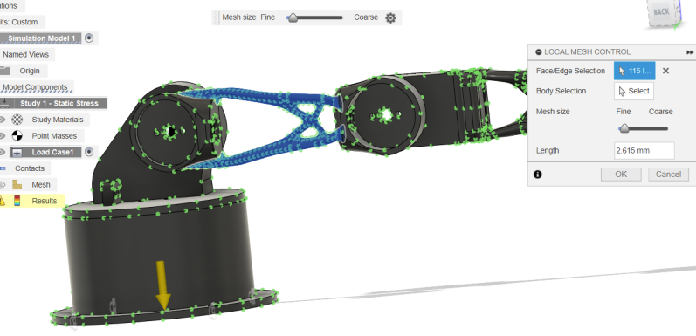
Stress Analysis

Slide 11
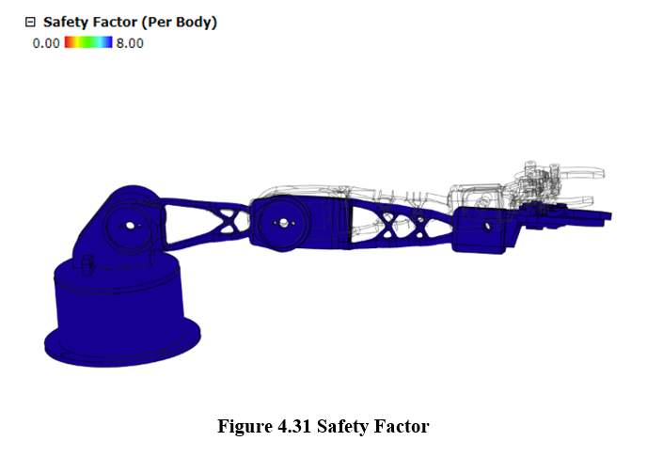
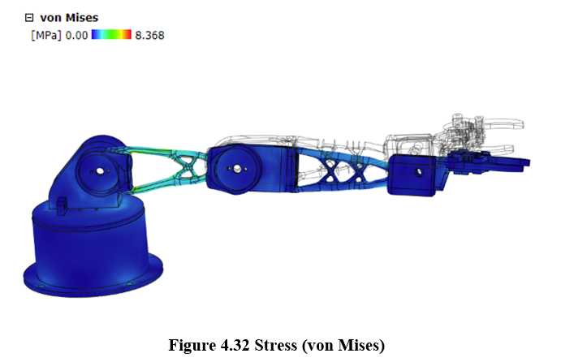
Stress Analysis

Slide 12
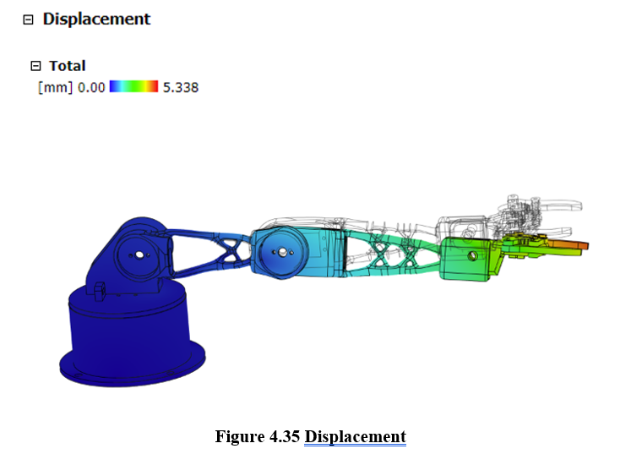
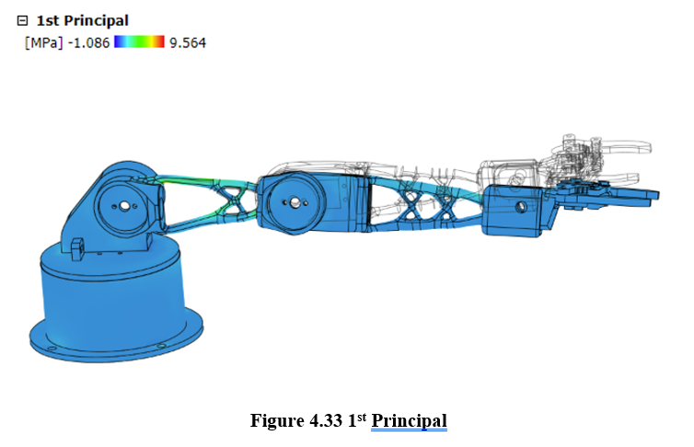
Stress Analysis

Slide 13
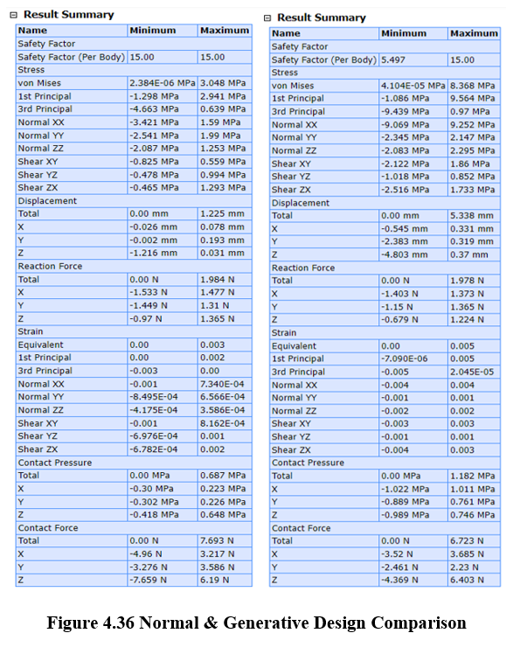
Stress Analysis
Results

Slide 14
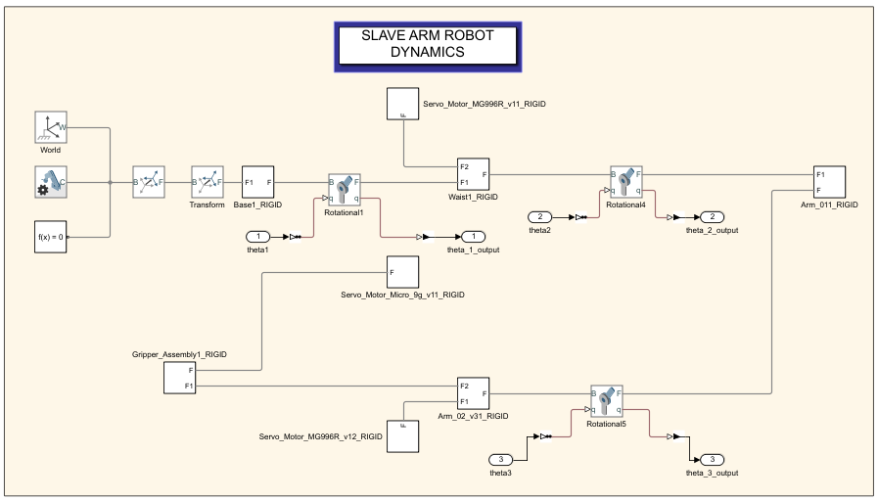
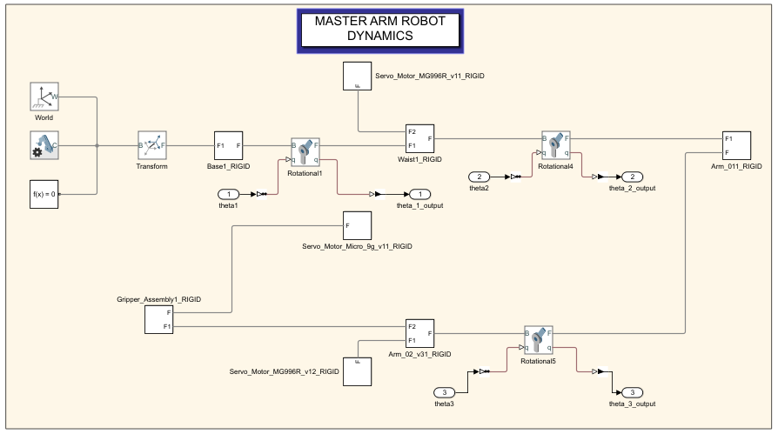
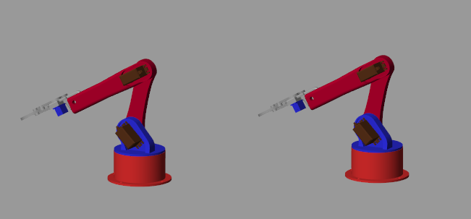
MULTIBODY ROBOT DYNAMICS & SIMSCAPE SIMULATION OUTPUT

Slide 15
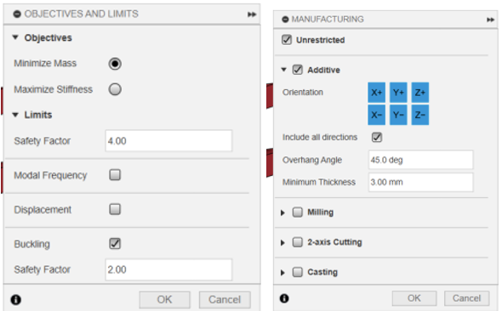
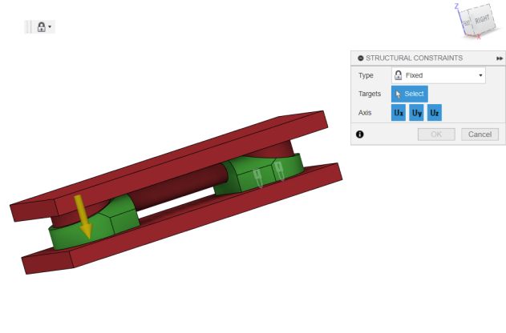
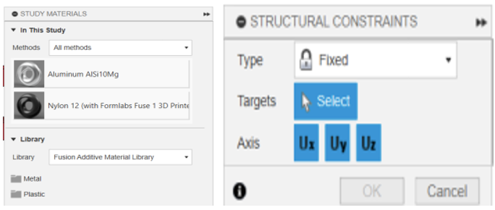
CONCEPTUAL DESIGN & UNIQUENESS

Slide 16
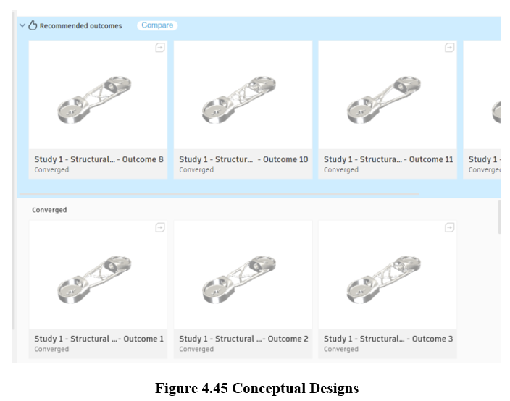
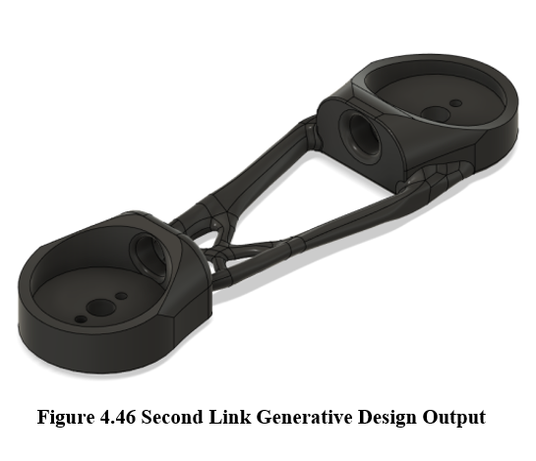
CONCEPTUAL DESIGN & UNIQUENESS

Slide 17
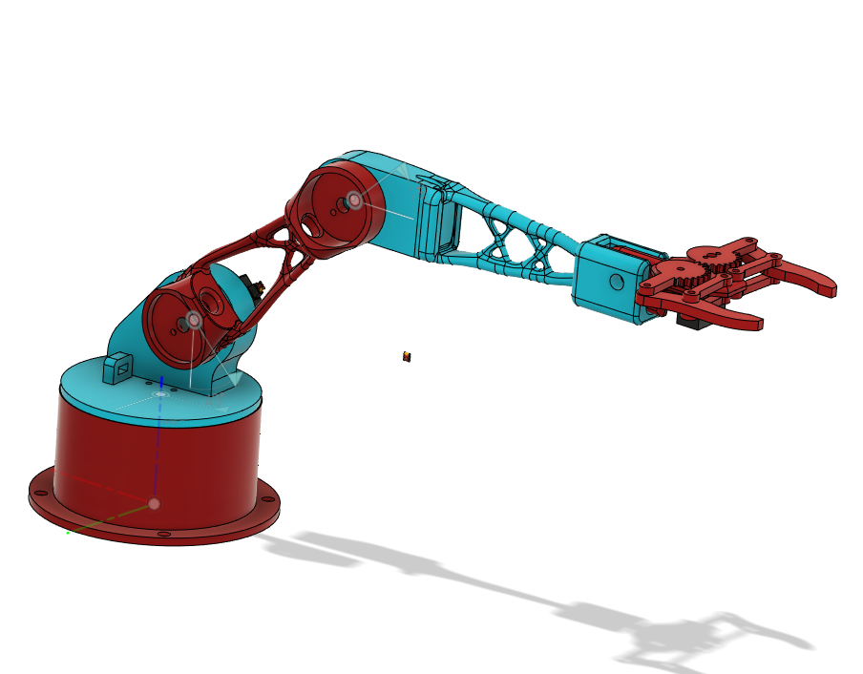
UNIQUE DESIGN WITH GENERATIVE DESIGN

Slide 18
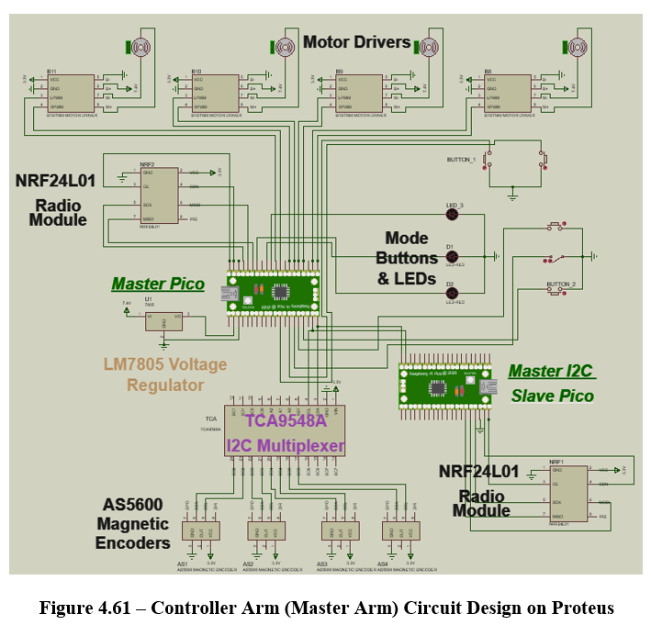
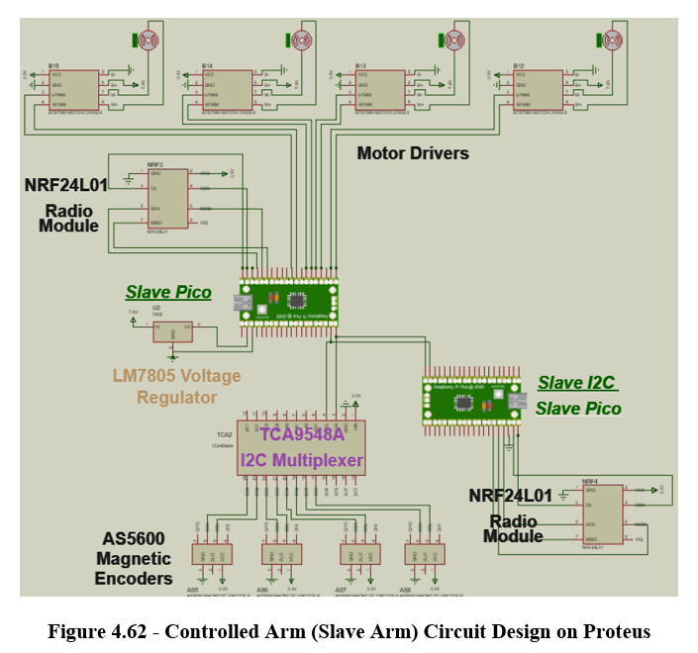
Electronical Design Realization

Slide 19
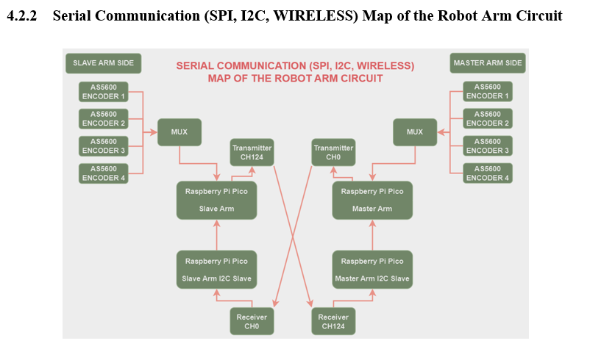
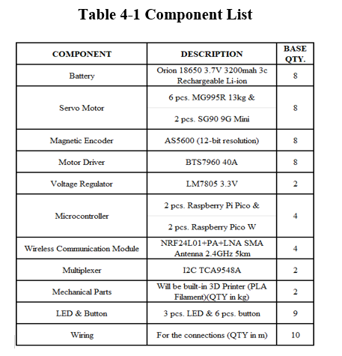
Electronical Design Realization

Slide 20
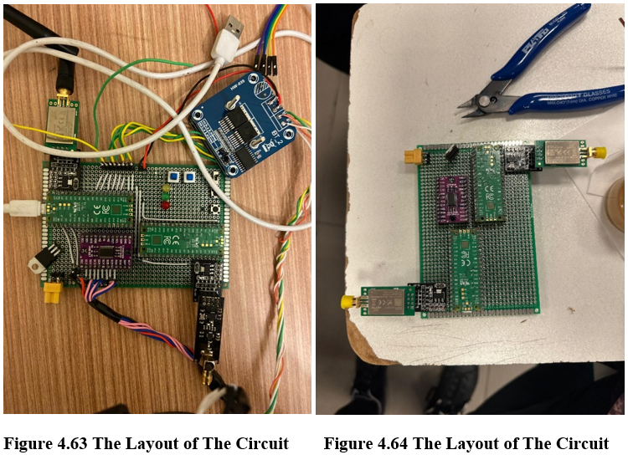
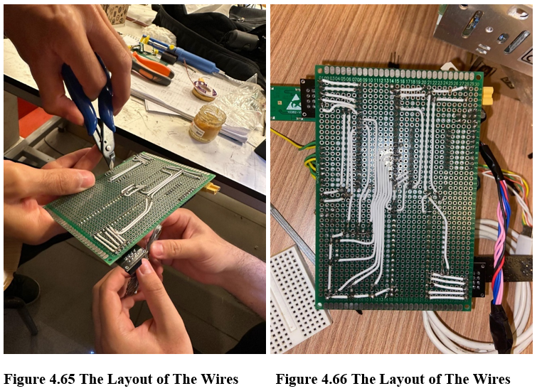
Electronical Design Realization

Slide 21
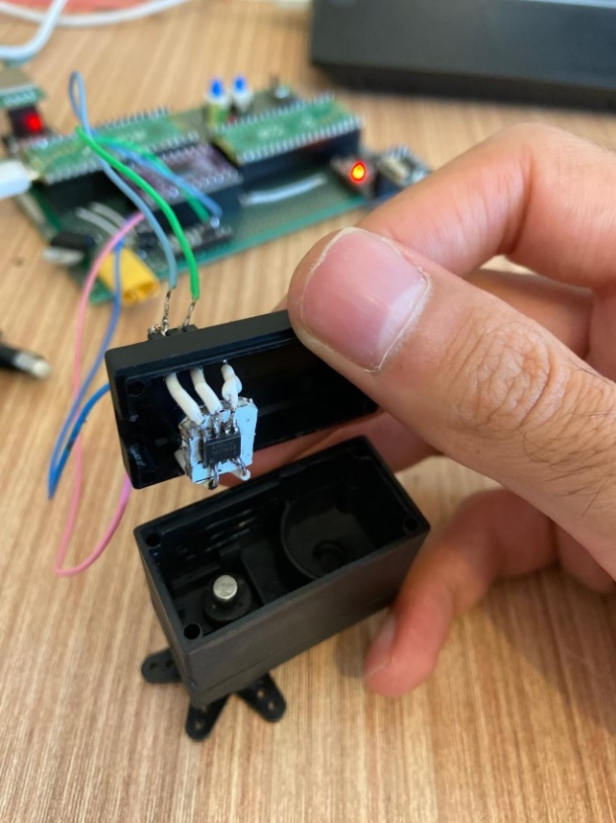
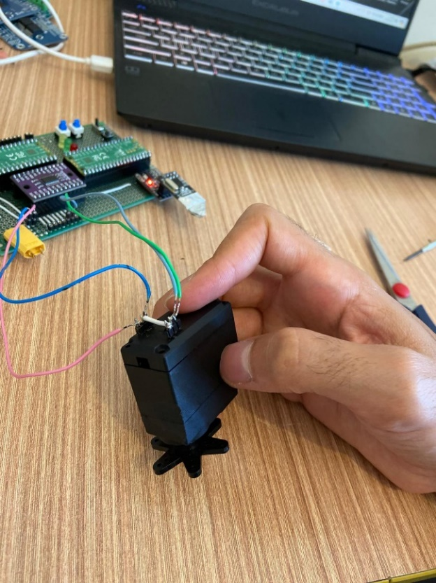
Electronical Design Realization

Slide 22
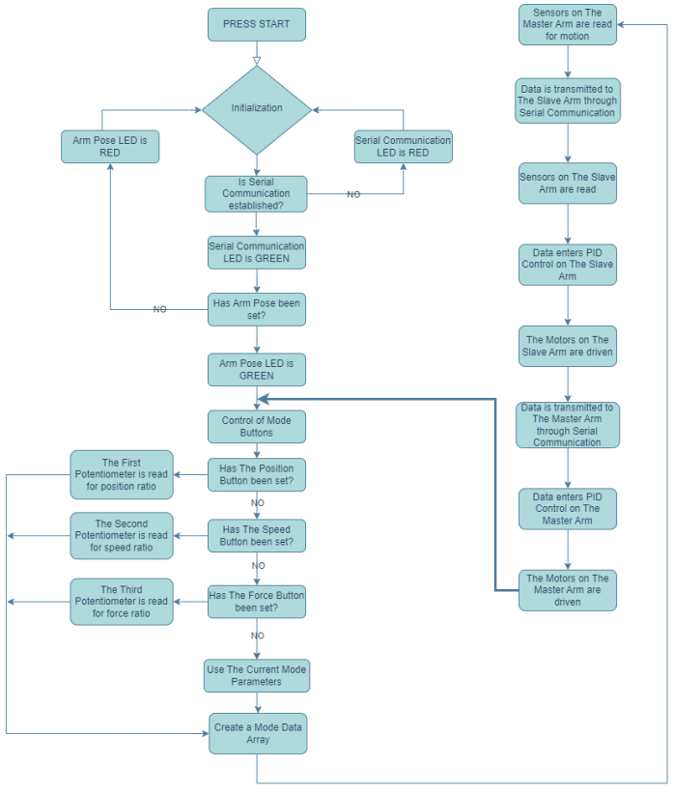
SOFTWARE & ALGORYTHM

Slide 23
SOFTWARE & ALGORYTHM
In the electronic design, four separate code bases were created for the four microcontrollers: Master Arm, Master Arm I2C Slave, Slave Arm, and Slave Arm I2C Slave.
Each code handles communication and control for its respective microcontroller. For example, the Master Pico code communicates with the Master Arm I2C Slave via I2C and receives data from the NRF24L01, which sets the master arm's setpoint based on the slave arm's encoder data.
Feedback from the master arm's encoders is transmitted to the Slave Pico as setpoints. These setpoints and feedback data are used in PID control to manage the motors.
The code includes necessary libraries, force transmission coefficients, functions, and defines angular motion limits for each joint. Comments and optimizations ensure clarity and efficient operation. The same setup applies to the Slave Arm.
To view the codes, please refer to the code section in the Appendix;
Master Arm Code
Master Arm I2C Slave Code
Slave Arm Code
Slave Arm I2C Slave Code

Slide 24
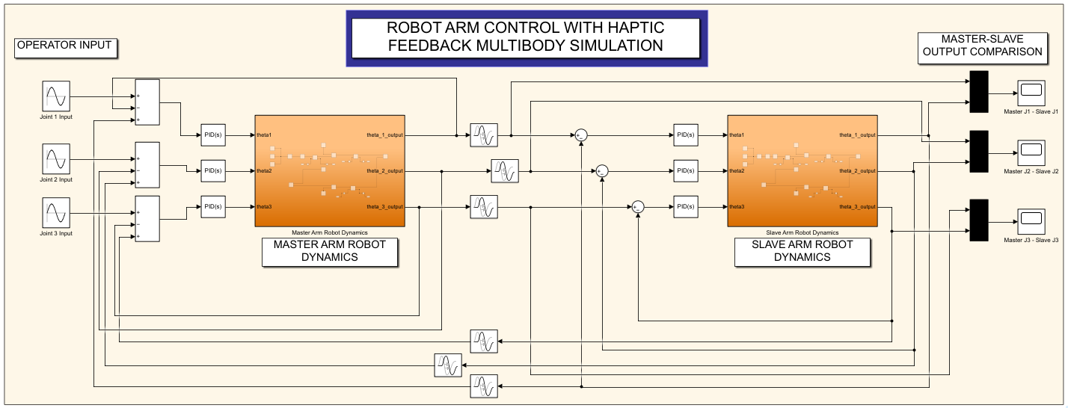
CONTROL

Slide 25
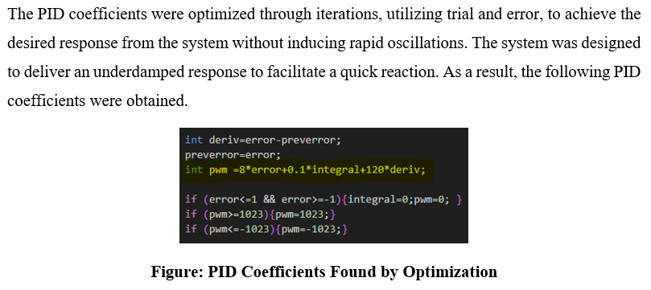
CONTROL

Slide 26
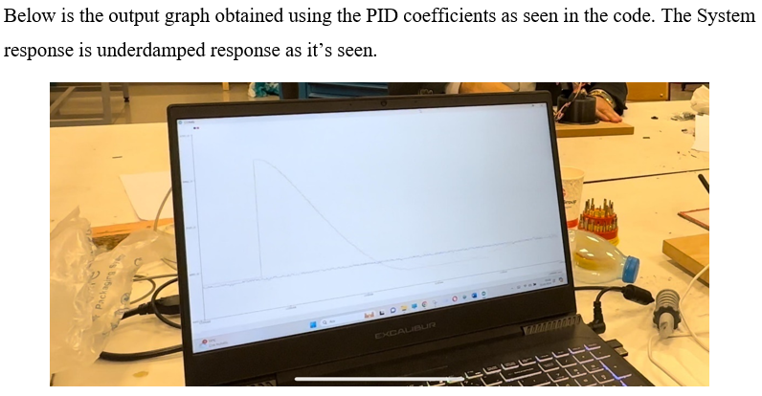
CONTROL

Slide 27
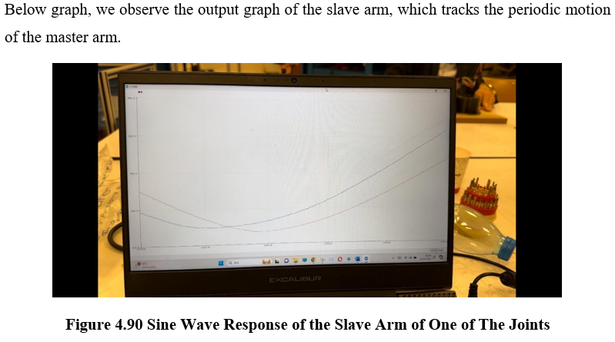
CONTROL

Slide 28
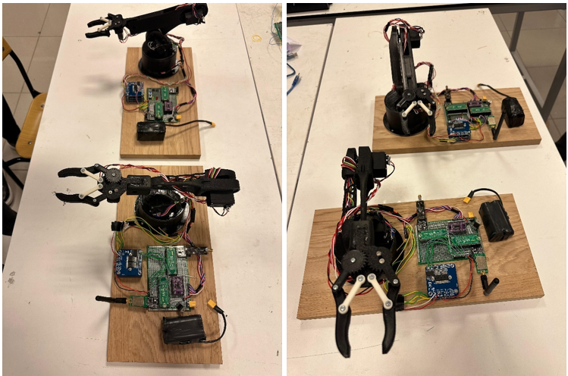
OVERALL SYSTEM VIEW
The images depict an overall system view encompassing the power, electronic, communication, and mechanical components of the robot arms. The robot arms are mounted on a wooden base.

Slide 29
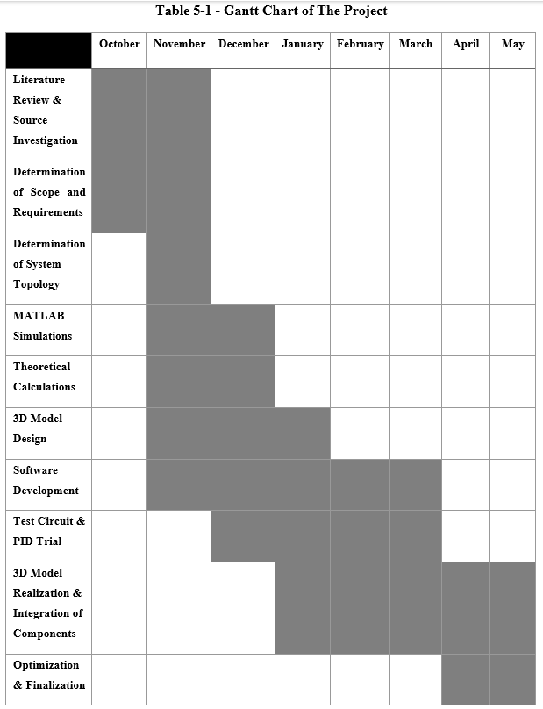
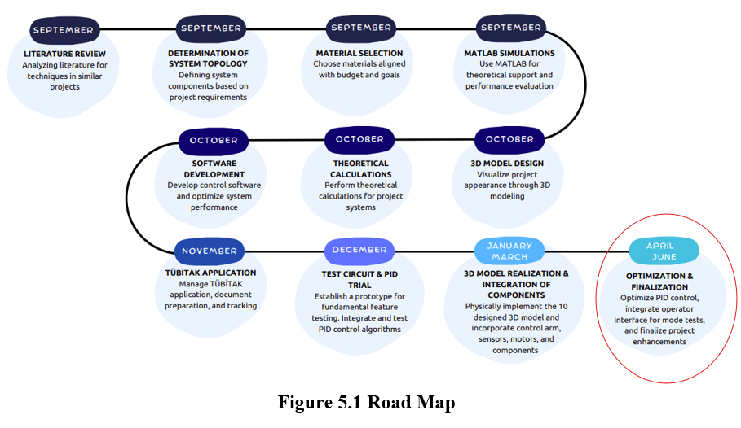
Final

Slide 30
THANK YOU
BACKUP SLIDES

Slide 31




Codes

Slide 32



Codes

Slide 33




Codes

